Slide 1



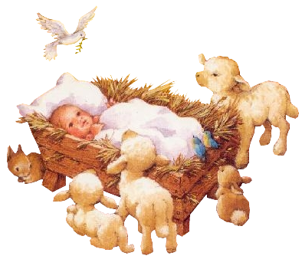
ΔΕΚΕΜΒΡΗΣ
Δ | Τ | Τ | Π | Π | Σ | Κ
 |  |  | 1 | 2 | 3 | 4
5 | 6 | 7 | 8 | 9 | 10 | 11
12 | 13 | 14 | 15 | 16 | 17 | 18
19 | 20 | 21 | 22 | 23 | 24 | 25
26 | 27 | 28 | 29 | 30 | 31
25

Slide 2
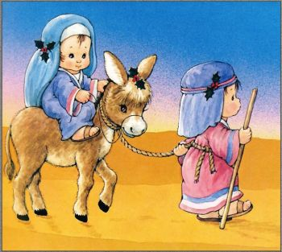

Slide 3
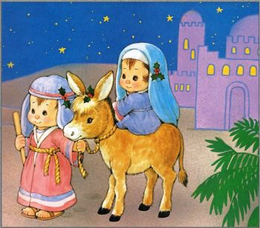

Slide 4
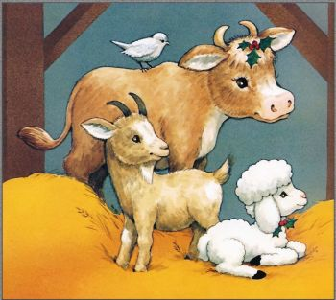

Slide 5
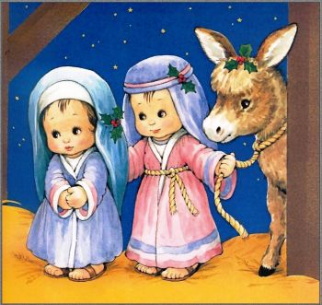

Slide 6
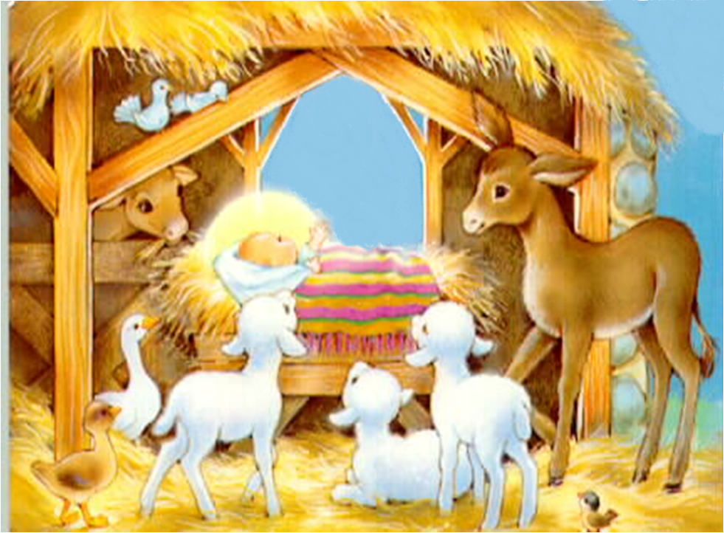


Slide 7
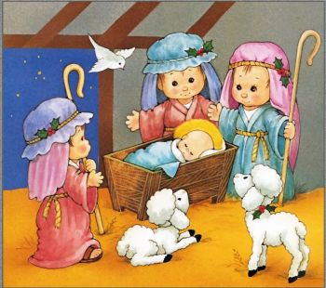

Slide 8
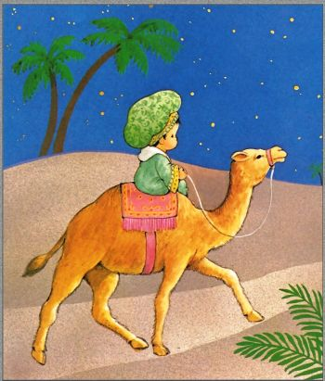
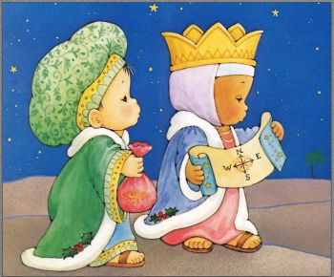
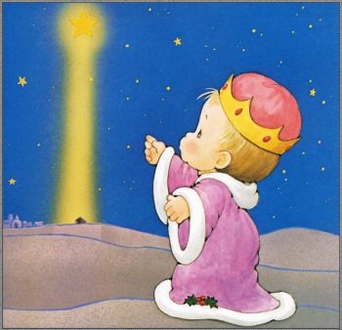

Slide 9


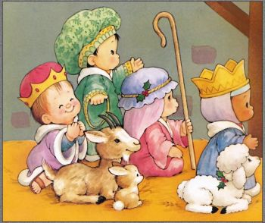
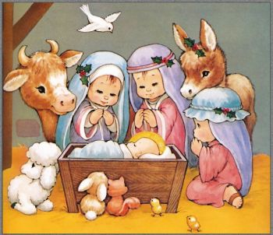

Slide 10

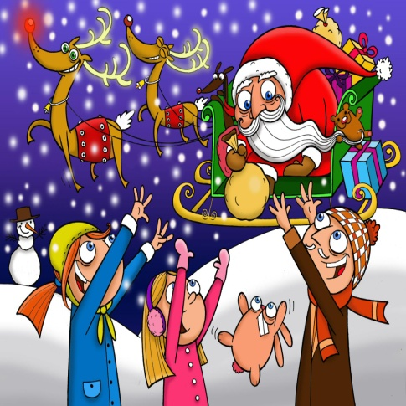


Slide 11


